Slide 1
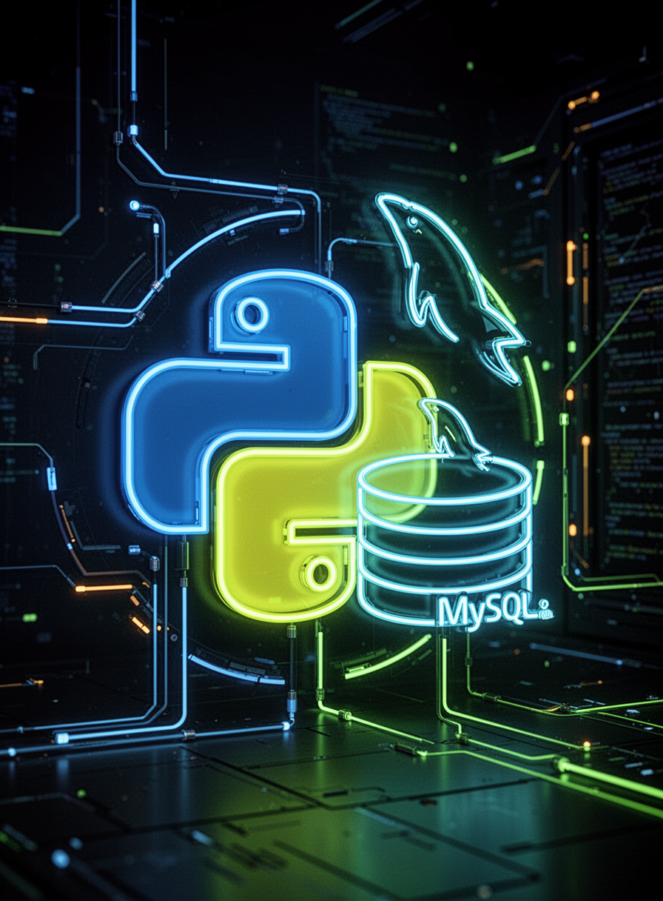

Python Data Solutions
Python with MySQL Connector
Mahak
March 18, 2026

Slide 2


DATABASES
What is a Database?
A database is a structured collection of data, designed to store, manage, and retrieve information efficiently. Common examples include student records, banking systems, and login systems.

Slide 3
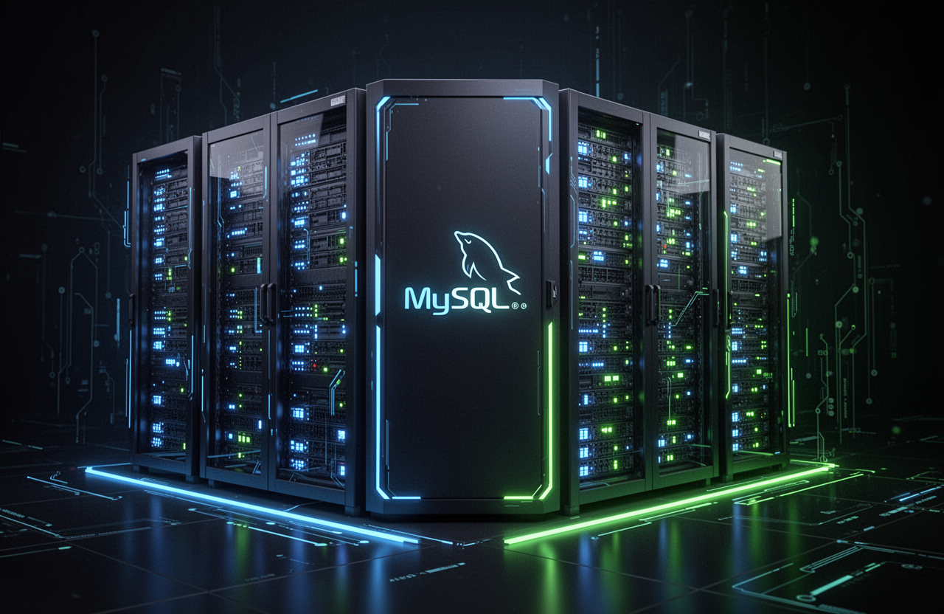
MYSQL OVERVIEW
Understanding MySQL Basics
MySQL is a widely-used relational database management system that utilizes SQL for data management, enabling developers to build robust and scalable applications with structured data handling.

Slide 4
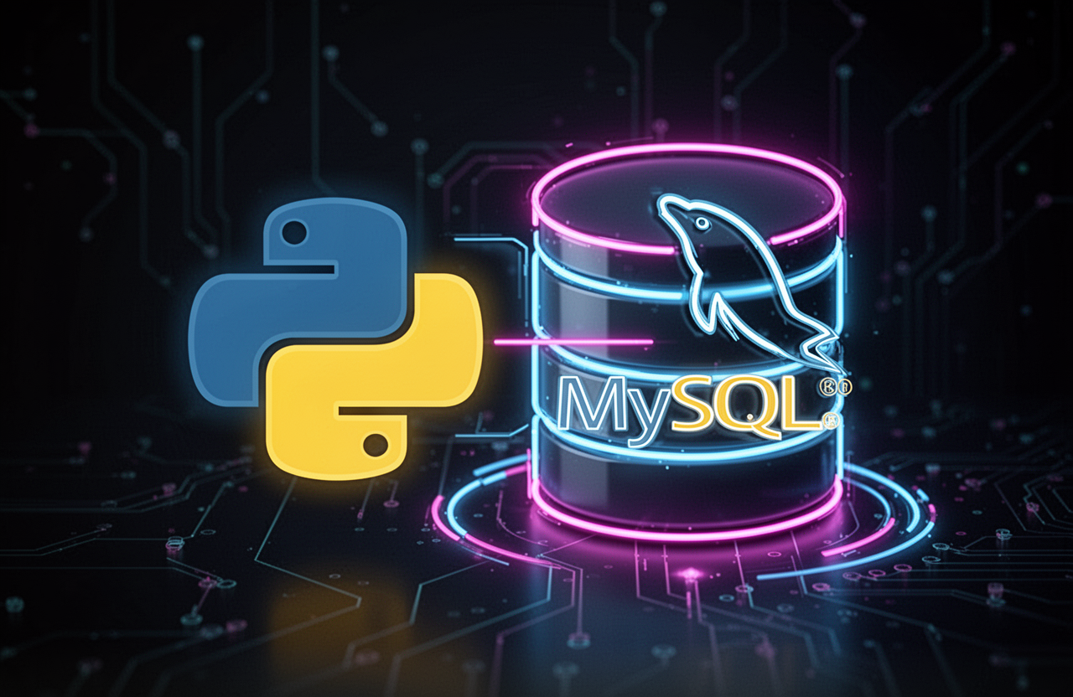
OVERVIEW
What is Python MySQL Connector?
The Python MySQL Connector is a powerful library that allows developers to connect Python applications with MySQL databases, enabling seamless execution of SQL queries and dynamic application development.

Slide 5
Key Benefits of Python with MySQL
Permanent Data Storage
Real-World Applications
Python and MySQL allow secure storage of data, ensuring it remains accessible for future use.
This combination enables the development of robust applications, serving various industries and user needs.
Automating Operations
Practical Examples
By integrating Python with MySQL, you can automate data management tasks, improving efficiency and accuracy.
Common use cases include Student Management Systems and Login Systems, showcasing their real-world applicability.

Slide 6
Installation Steps for MySQL Connector
Install MySQL
Open phpMyAdmin
Download and install MySQL server on your system to set up the database environment.
Access phpMyAdmin to manage your databases easily through a web interface with user-friendly tools.
Install Connector
Use pip Command
Get the MySQL connector library to allow Python to interact with the MySQL database seamlessly.
Execute the command pip install mysql-connector-python in your terminal to install the library efficiently.

Slide 7
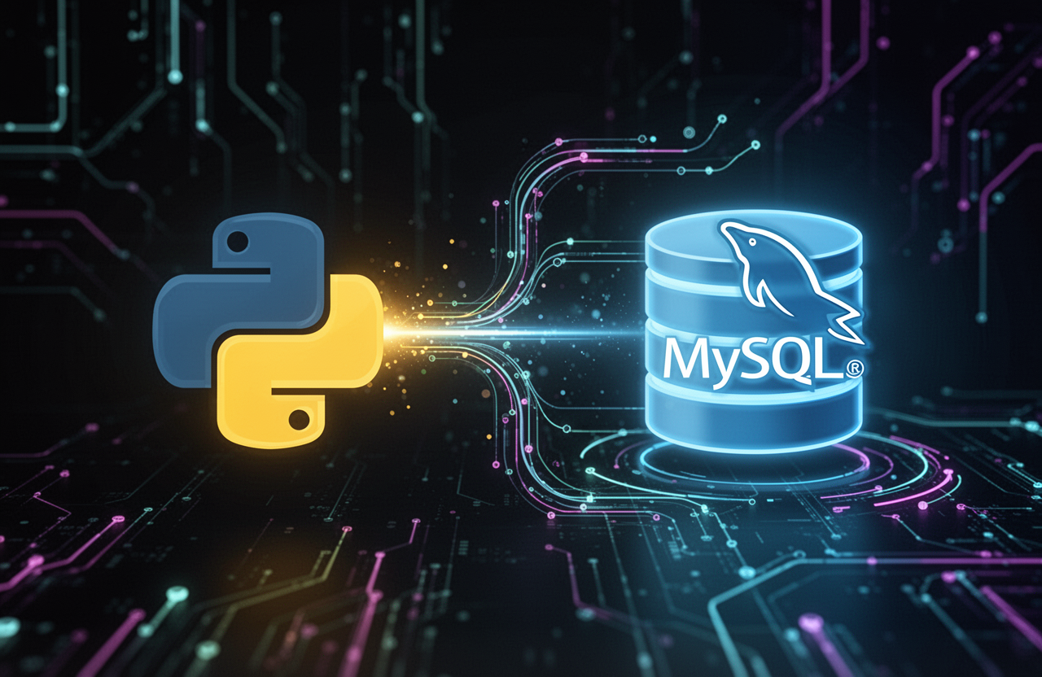
CONNECTION
Connecting Python to MySQL
Establishing a connection with MySQL is essential for executing SQL queries directly from Python, allowing for seamless data manipulation and retrieval in real-time applications.

Slide 8

TABLE CREATION
Creating a Database Table
In this section, we will explore how to create a structured table within a MySQL database. Tables are essential for storing organized data efficiently.

Slide 9
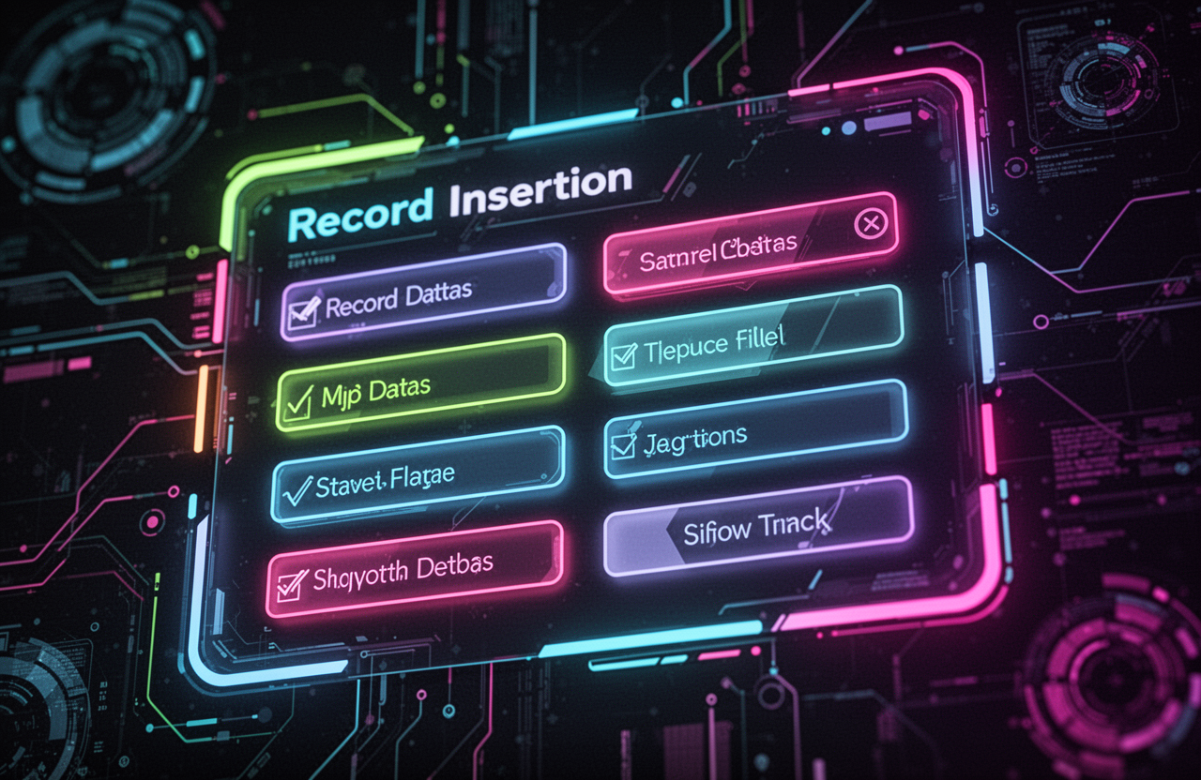
ADDING RECORDS
Insert Data into Tables
In this section, we will explore how to effectively add records to our database. This process is crucial for maintaining and managing data efficiently.

Slide 10

DATA RETRIEVAL
Fetching Data from Database
In this section, we will explore how to retrieve stored data efficiently from the MySQL database using Python. This process allows dynamic interaction with our applications.

Slide 11

DATA MANAGEMENT
Deleting Records Safely
Deleting records is crucial for maintaining a clean database. This process ensures that unwanted data is removed effectively, thus enhancing overall data integrity.

Slide 12
Overview of the Student Management System
Add Student
View Students
Users can easily add new student records into the database through a simple and intuitive interface.
The system allows users to retrieve and display student information in a user-friendly format for review.
Store Data
Real-World Example
All information is securely stored in a MySQL database, ensuring easy access and management of records.
This project serves as a practical application, demonstrating how Python and MySQL can be integrated effectively.

Slide 13

LIVE DEMO
Sharing the System Online
Transforming the Python program into a web app allows students to access the system online, promoting collaboration and real-time updates for managing student data efficiently.

Slide 14
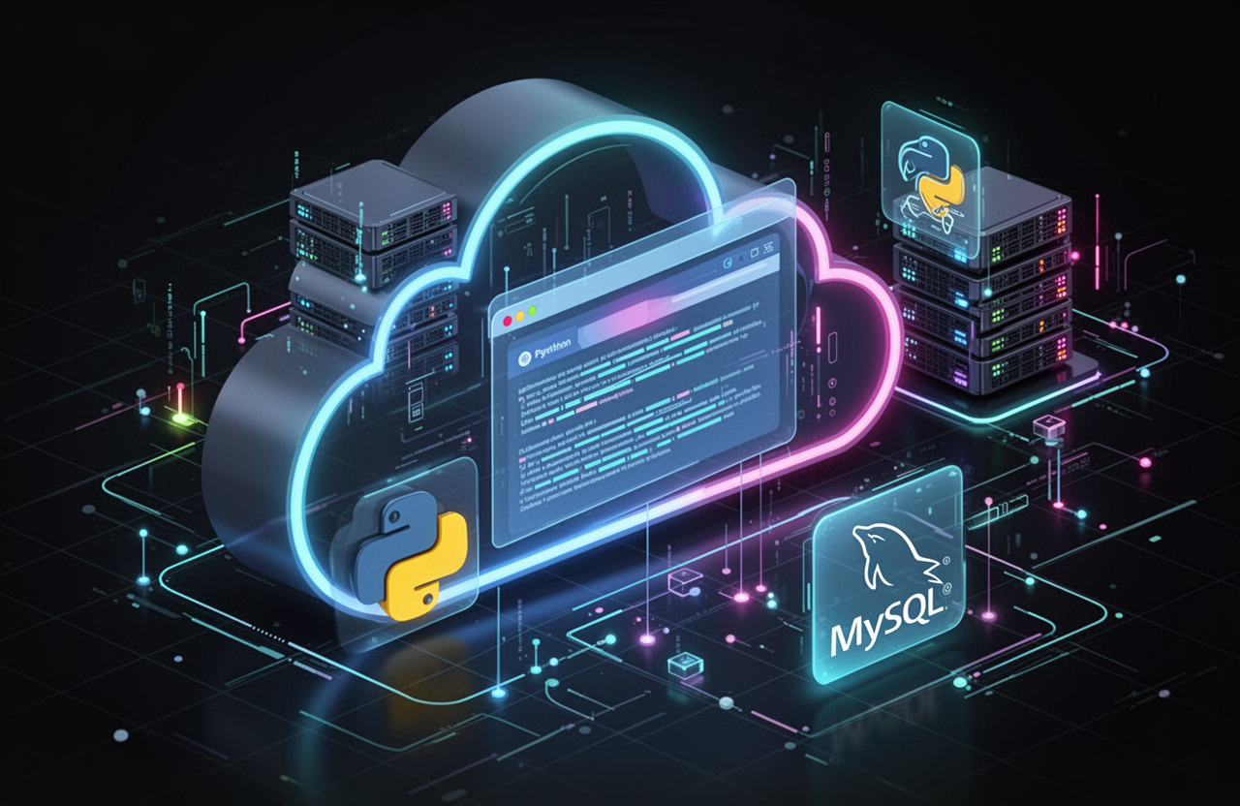
HOSTING OPTIONS
Web Interface Hosting Ideas
Explore various options for hosting your Python and MySQL application, including Streamlit for web interfaces and Ngrok for easy sharing with users.

Slide 15
Key Takeaways from the Presentation
Powerful Combination
Real-World Development
The synergy between Python and MySQL creates robust applications for data management and analysis.
This combination is widely utilized in developing practical software solutions across various industries.
Backend Systems
Versatile Applications
Python and MySQL are essential for constructing efficient backend systems that handle complex data operations.
They support diverse applications, from simple data logging to advanced data analysis and reporting systems.

Slide 16
Thank You!
For further questions, reach out at hello@reallygreatsite.com or visit reallygreatsite.com

